Slide 1
2012 Greater Fargo-Moorhead Community Health Needs Assessment of Community Leaders
Results of a May 2012 Survey of Community Leaders in Cass County, North Dakota and Clay County, Minnesota

Slide 2
Introduction
Purpose:
  Explore views of key leaders in F-M metro area
  Key leaders
    Elected leadership
    Nonprofit leaders
    Health professionals
    Social workers
    Educators
  Views on
    Population’s health
    Prevalence of disease and health issues
Results of this survey are not generalizable

Slide 3
Study Design and Methodology
Study Design
  Developed in collaboration with Fargo-Moorhead Community Health Needs Assessment Collaborative (FMCHNAC)
  Electronic survey – contained 30 questions
  Questions focused on:
    Community assets/best thing about the community
    General concerns about the community
    Health and wellness concerns about the community
    Personal health care information
    Demographic information
Methodology
  Community leaders invited to a breakfast meeting sponsored by the FMCHNAC
  List of invitees generated by members of the Collaborative
  Written survey administered at the breakfast meeting
  Survey data hand-entered into Internet-based survey tool (Survey Monkey)
  Leaders not able to attend were contacted via e-mail with instructions for them to fill out the survey
  58 surveys completed (including 44 at the breakfast meeting and 14 via Internet survey link)
  Findings not generalizable to the community
    But offer important insight and should be interpreted as anecdotal narrative

Slide 4
Key Findings
Community Assets/Best Things About the Community
High levels of agreement that community:
  Has educational opportunities and programs
  Is a good place to raise kids
  Has quality health care
Agreed the least that
  There is tolerance, inclusion, and open-mindedness

Slide 5
Key Findings
General Concerns About the Community
Highest levels of concern were for:
  Safety issues
  The aging population
  Children and youth
Lowest levels of concern were for:
  Environmental issues

Slide 6

Key Findings
Most concern for:
Safety issues
  Domestic violence
  Child abuse and neglect

Slide 7

Key Findings
Most concern for:
The aging population
  Availability/cost of long-term care
  Availability of resources to help elderly stay in their homes
  Availability of resources for family and friends caring for elders

Slide 8

Key Findings
Most concern for:
Children and youth
  Availability/cost of quality child care
  Bullying

Slide 9
Key Findings
Health and Wellness Concerns About the Community
Highest levels of concern were for:
  Cost and access issues
  Physical and mental health issues
Least concerned about:
  Patient confidentiality
  Distance to health care services

Slide 10

Key Findings
Most concern for:
Cost and access issues
  The cost of health insurance
  The cost of health care
  The cost of prescription drugs
  Adequacy of health insurance
  Access to health insurance coverage

Slide 11

Key Findings
Most concern for:
Physical and mental health
  Obesity
  Poor nutrition and eating habits
  Inactivity or lack of exercise
  Chronic disease
  Depression

Slide 12
SURVEY RESULTS

Slide 13

Survey Results
Community Assets/Best Things About Their Community
People
Services and resources
Quality of life

Slide 14
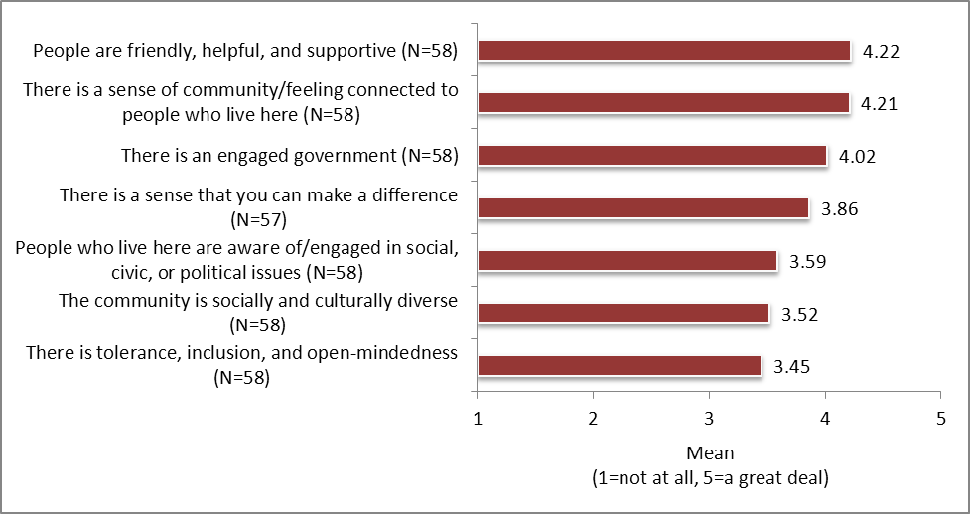
Respondents’ level of agreement with statements about their community regarding PEOPLE
Respondents agree most that:
  People are friendly, helpful, and supportive
  There is a sense of community or feeling connected to people who live here
Respondents agree least that:
  There is tolerance, inclusion, and open-mindedness (although still a moderate level of agreement)

Slide 15
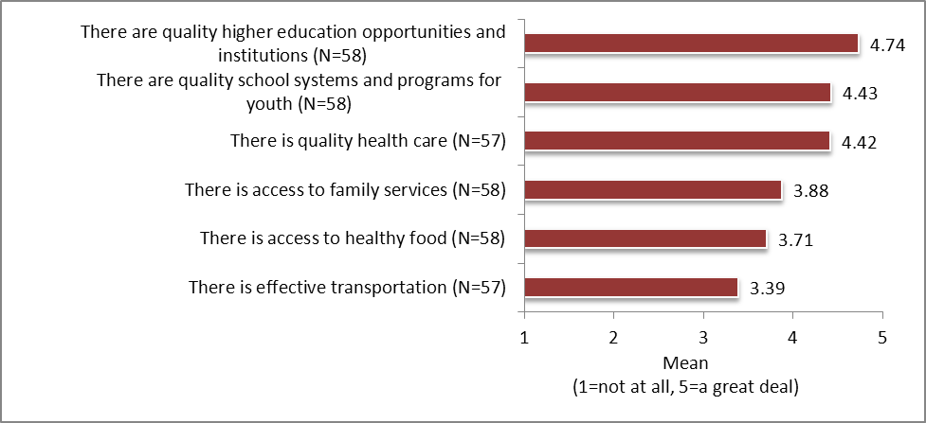
Respondents’ level of agreement with statements about their community regarding
SERVICES AND RESOURCES
Respondents agree most that:
  There are quality higher education opportunities and institutions
  There are quality school systems and programs for youth
  There is quality health care
Respondents agree the least that:
  There is effective transportation (although still a moderate level of agreement)

Slide 16
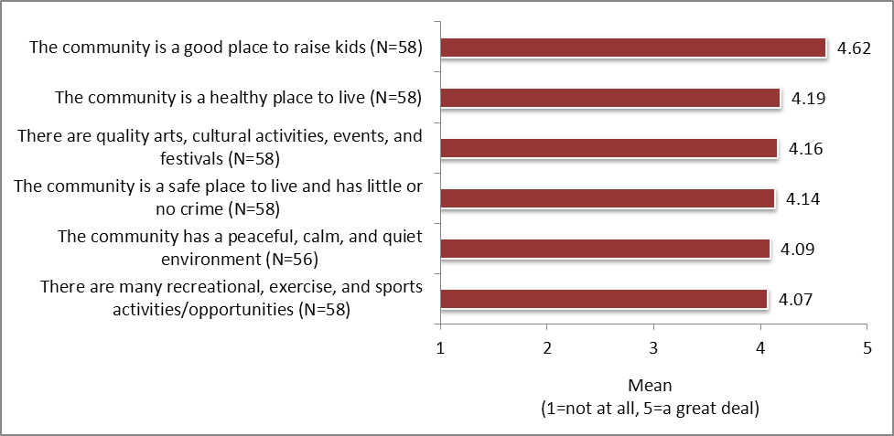
Respondents’ level of agreement with statements about their community regarding QUALITY OF LIFE
Respondents agree the most that:
  Their community is a good place to raise kids
  Their community is a healthy place to live
Respondents agree the least that:
  There are many recreational, exercise, and sports activities/opportunities (although still a high level of agreement)

Slide 17

Survey Results
General Concerns About Their Community
Economic Issues
Transportation
Environment
Children and Youth
The Aging Population
Safety

Slide 18
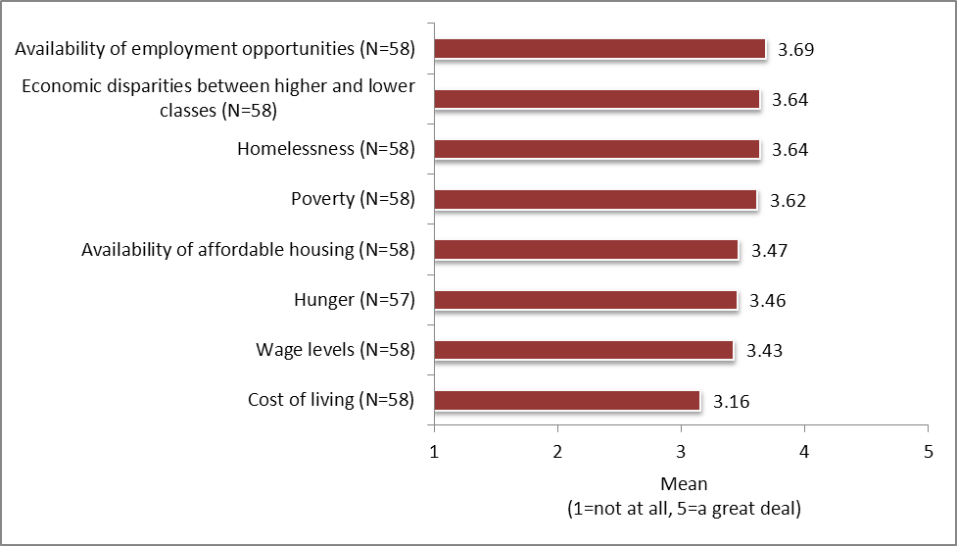
Respondents’ level of concern with statements about their community regarding ECONOMIC ISSUES
Respondents are most concerned about:
  Availability of employment opportunities
  Economic disparities between higher and lower classes
  Homelessness
  Poverty
Respondents are least concerned about:
  Cost of living (although still moderately concerned)

Slide 19
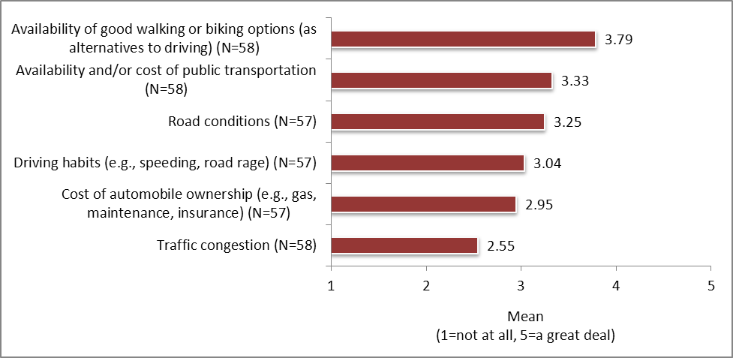
Respondents’ level of concern with statements about their community regarding TRANSPORTATION
Respondents are most concerned about:
  Availability of good walking or biking options
  Availability and cost of public transportation
  Road conditions
Respondents are least concerned about:
  Traffic congestion

Slide 20
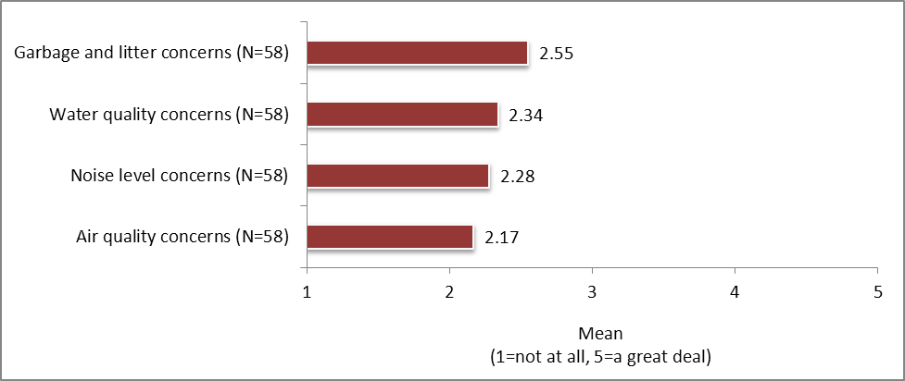
Respondents’ level of concern with statements about their community regarding the ENVIRONMENT
Overall, respondents are not that concerned with environmental issues
Respondents have a higher level of concern with garbage and litter than with water quality, noise level, and air quality issues

Slide 21
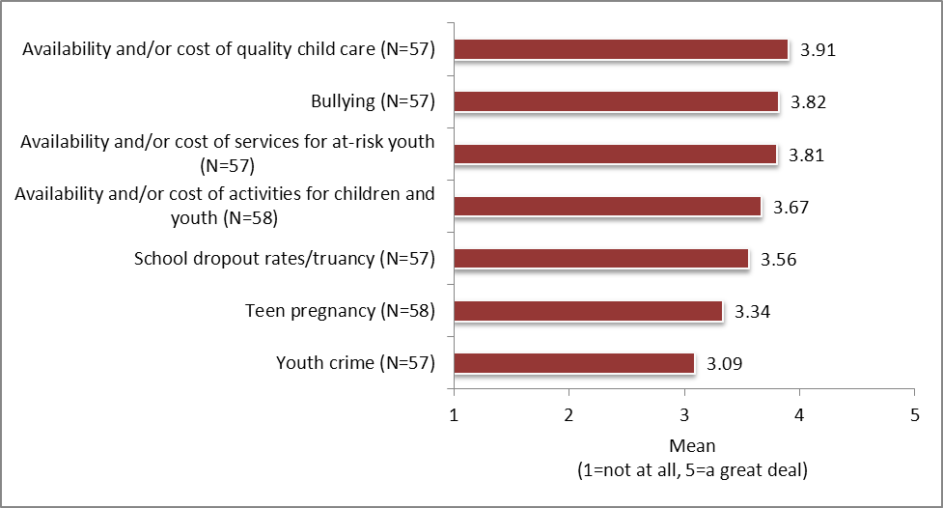
Respondents’ level of concern with statements about their community regarding CHILDREN AND YOUTH
Respondents are most concerned about:
  Availability or cost of quality child care
  Bullying
  Availability and cost of services for at-risk youth
Respondents are least concerned about:
  Youth crime (although still moderately concerned)

Slide 22
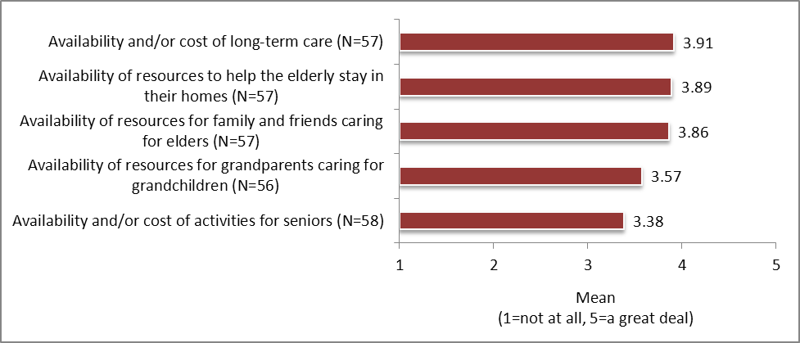
Respondents’ level of concern with statements about their community regarding THE AGING POPULATION
Respondents are most concerned about:
  Availability and cost of long-term care
  Availability of resources to help the elderly stay in their homes
  Availability of resources for family and friends caring for elders
Respondents are least concerned about:
  The availability and cost of activities for seniors (although still moderately concerned)

Slide 23
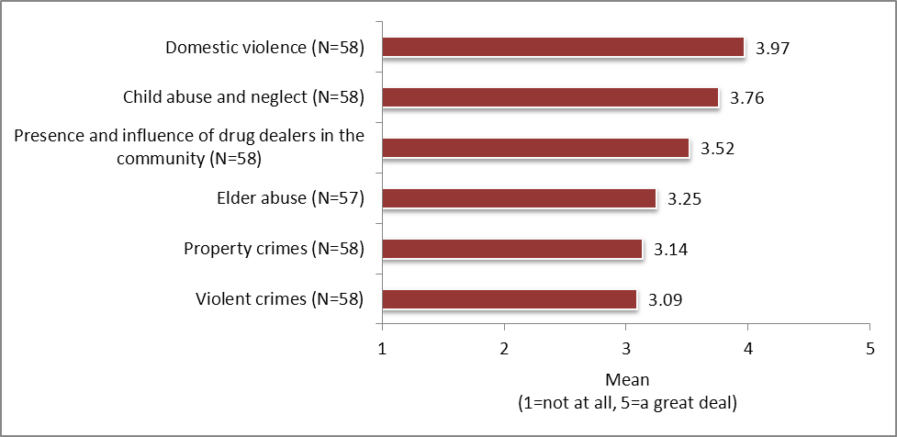
Respondents’ level of concern with statements about their community regarding SAFETY
Respondents are most concerned about:
  Domestic violence
  Child abuse and neglect
  Presence and influence of drug dealers
  Respondents are least concerned about:
    Violent crimes (although still moderately concerned)

Slide 24

Survey Results
Health and Wellness Concerns About Their Community
Access to health care
Physical and mental health
Substance use and abuse

Slide 25
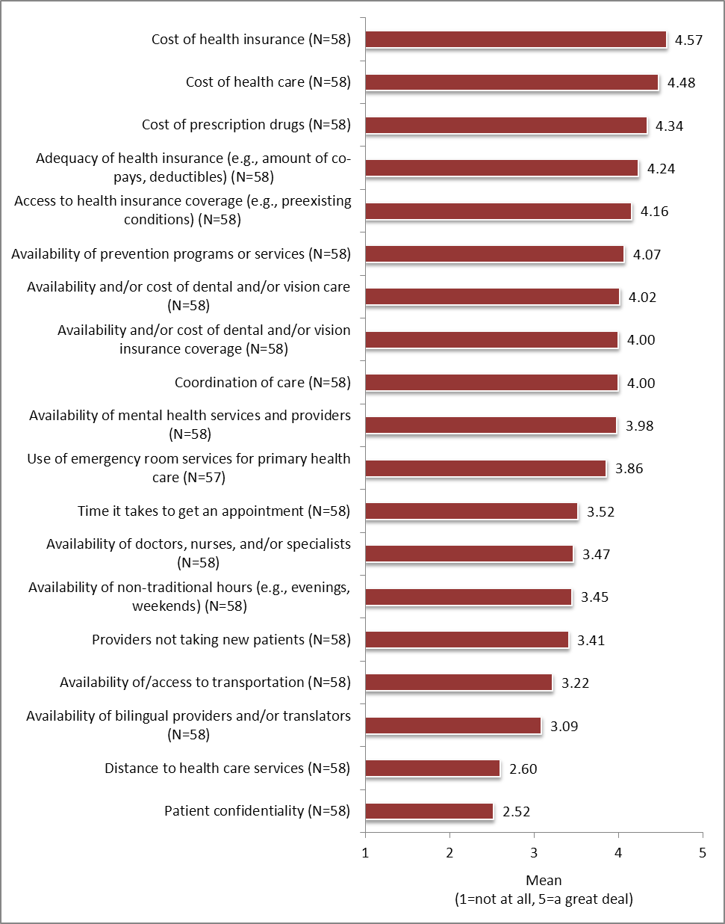
Respondents’ level of concern with statements about their community regarding ACCESS TO HEALTH CARE
Respondents are most concerned about:
  Cost of health insurance
  Cost of health care
  Cost of prescription drugs
  Adequacy of health insurance (e.g., amount of copays, deductibles)
Respondents have moderately high levels of concern about:
  Access to health insurance coverage (e.g., preexisting conditions)
  Availability of prevention programs or services
  Availability and/or cost of dental and/or vision care
  Coordination of care
  Availability and/or cost of dental and/or vision insurance coverage
  Availability of mental health services and providers
Respondents are least concerned about:
  Distance to health care services
  Patient confidentiality

Slide 26
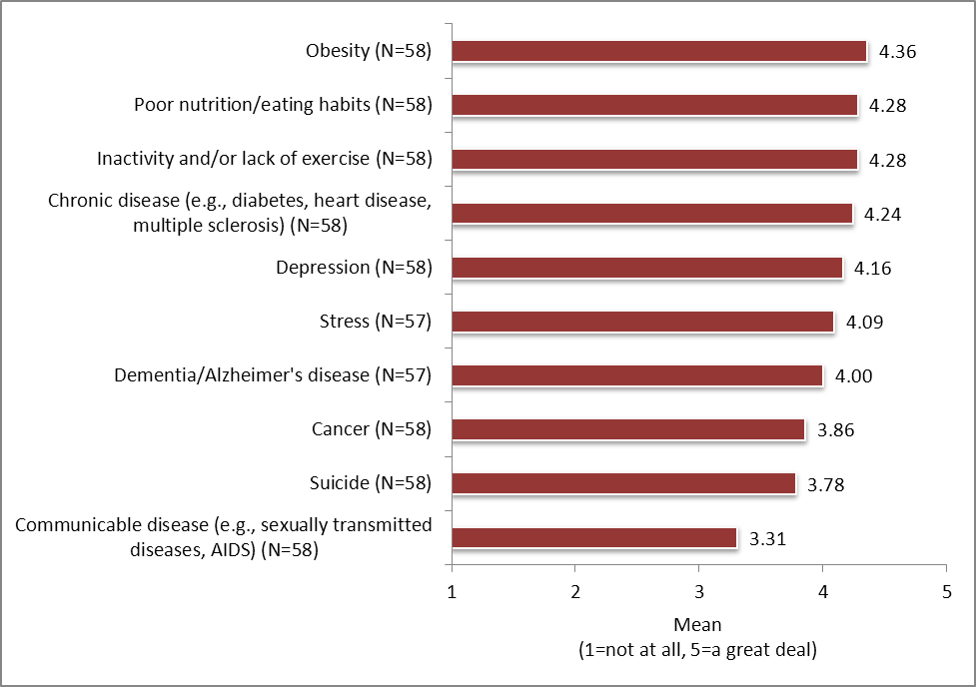
Respondents’ level of concern with statements about their community regarding
PHYSICAL AND MENTAL HEALTH
Respondents are most concerned about:
  Obesity
  Poor nutrition and eating habits
  Inactivity and/or lack of exercise
  Chronic disease
    Respondents are least concerned about:
      Communicable disease (although still a moderate level of concern)

Slide 27
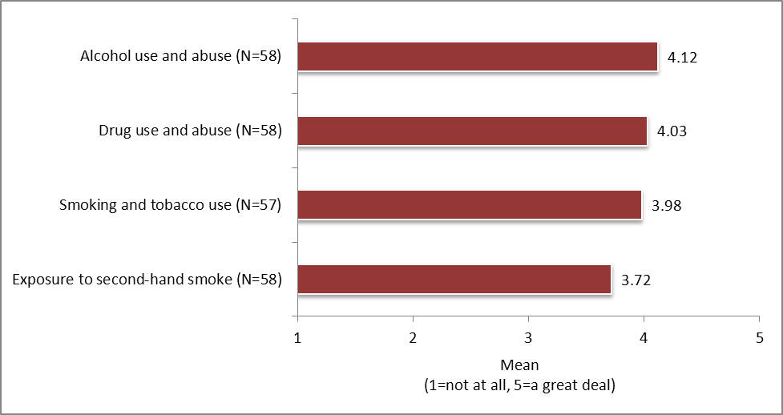
Respondents’ level of concern with statements about their community regarding SUBSTANCE USE AND ABUSE
Respondents’ have similarly high levels of concern regarding substance use and abuse issues
Respondents are most concerned about:
  Alcohol use and abuse
  Drug use and abuse
    Respondents are least concerned about:
      Exposure to second-hand smoke (although still a fairly high level of concern)

Slide 28

Survey Results
Personal Health Care Information

Slide 29
Respondents’ primary health care provider
Three in five respondents use Sanford Health
One in four use Essentia Health
Primary health care provider | Percent of respondents*
Sanford Health | 62.1
Essentia Health | 27.6
Independent Family Doctors | 15.5
Family HealthCare Center | 3.4
Did not access health care in last 12 months | 1.7
Use emergency room/urgent care for primary care services | 0.0
Other: | 3.4
St. Alexius Medical Center in Bismarck (2)
Trinity Medical Center in Minot (1)
N=58
*Percentages do not equal 100.0 due to multiple responses.

Slide 30
Respondents’ reasons for choosing primary health care provider
Top three reasons:
  Quality of services
  Influenced by health insurance
  Location
Reasons for choice of primary health care provider | Percent of respondents*
Quality of services | 39.7
Influenced by health insurance | 29.3
Location | 27.6
Availability of services | 25.9
Sense of being valued as a patient | 25.9
Cost | 5.2
Other: | 15.5
Followed physician (2)
Referral/recommendation (2)
Keep medical records in one place (2)
Provider relationships (2)
Have been there many years (1)
Employed there (1)
N=58
*Percentages do not equal 100.0 due to multiple responses.

Slide 31
Whether respondents have had a cancer screening or cancer care in the past year
Less than one in five have not had a cancer screening or cancer care in the past year
Cancer screening/cancer care | Percent of respondents (N=58)
Yes | 82.8
No | 17.2
Total | 100.0

Slide 32
Among respondents who have not had a cancer screening or cancer care in the past year, reasons for not having done so
60% because it was not necessary
10% because of fear
10% because of unfamiliarity with recommendations
10% because of not knowing who to see
Reason for not having a cancer screening/care | Percent of respondents*
Not necessary | 60.0
Fear | 10.0
Cost | 0.0
Unfamiliar with recommendations | 10.0
Doctor hasn’t suggested | 0.0
Unable to access care | 0.0
I don’t know who to see | 10.0
Other: | 30.0
Time constraints: need after work hours (2)
Personal reasons (1)
N=10
*Percentages do not equal 100.0 due to multiple responses.

Slide 33
Methods respondents have used to pay for health care costs over the past 12 months
Vast majority paid with health insurance through an employer (91.4%)
Second highest method was using personal income (43.1%)
Paying for health care costs | Percent of respondents*
Health insurance through an employer | 91.4
Personal income (e.g., cash, check, credit) | 43.1
Private health insurance | 5.2
Medicare | 1.7
Medicaid | 1.7
Did not access health care in last 12 months | 0.0
Other | 0.0
N=58
*Percentages do not equal 100.0 due to multiple responses.

Slide 34

Survey Results
Demographic Information

Slide 35
Respondents’ age
Two out of three respondents are 45 to 64 years of age
One in four are 30 to 44 years of age
Age | Percent of respondents (N=58)
18 to 29 years | 1.7
30 to 44 years | 25.9
45 to 64 years | 67.2
65 to 74 years | 5.2
75 years or older | 0.0
Prefer not to answer | 0.0
Total | 100.0

Slide 36
Respondents’ highest level of education
Nine in 10 have a Bachelor’s degree or higher, including 58.6% who have a graduate or professional degree
Highest level of education | Percent of respondents (N=58)
Some high school | 0.0
High school diploma or GED | 3.4
Some college/no degree | 3.4
Associate’s degree | 3.4
Bachelor’s degree | 31.0
Graduate or professional degree | 58.6
Prefer not to answer | 0.0
Total | 99.8

Slide 37
Respondents’ gender
Two in three respondents are female
Gender | Percent of respondents (N=58)
Male | 34.5
Female | 65.5
Prefer not to answer | 0.0
Total | 100.0

Slide 38
Whether respondents work/volunteer outside the home
Nearly all work or volunteer outside the home
Work/volunteer | Percent of respondents (N=58)
Yes | 98.3
No | 1.7
Prefer not to answer | 0.0
Total | 100.0

Slide 39
Respondents’ annual household income before taxes
Two in five have an annual income of $70,000 to $119,999
One in three have an annual income of $120,000 or more
Annual household income before taxes | Percent of respondents (N=57)
Less than $20,000 | 0.0
$20,000 to $39,999 | 1.8
$40,000 to $69,999 | 19.3
$70,000 to $119,999 | 38.6
$120,000 or more | 35.1
Do not know/prefer not to answer | 5.3
Total | 100.1

Slide 40
Whether respondents own or rent their home
The vast majority of respondents own their home
Tenure | Percent of respondents (N=58)
Own | 94.8
Rent | 3.4
Prefer not to answer | 1.7
Other | 0.0
Total | 99.9

Slide 41
Respondents’ race or ethnicity
The vast majority of respondents are white
Race/ethnicity | Percent of respondents*
White | 96.6
Black/African American | 0.0
Native American/Alaska Native | 0.0
Asian/Pacific Islander | 0.0
Hispanic | 3.4
Other | 0.0
*Percentages do not equal 100.0 due to multiple responses.

Slide 42
Whether respondents are the parent or primary caregiver of a child or children
18 years of age or younger
One in three respondents are the parent or primary caregiver of a child or children 18 years of age or younger
Parent or primary caregiver | Percent of respondents (N=58)
Yes | 34.5
No | 65.5
Prefer not to answer | 0.0
Total | 100.0

Slide 43
Respondents’ area of employment
Most respondents are employed in health care, followed by government, and educational services
Area of employment | Percent of respondents*
Health care | 37.9
Government | 29.3
Educational services | 25.9
Retail trade | 1.7
Arts/entertainment | 0.0
Agriculture | 0.0
Construction | 0.0
Manufacturing | 0.0
Not applicable | 0.0
Other: | 24.1
Social services (4)
Non-profit (4)
Financial services (2)
Law (1)
Retired (1)
Higher education (1)
Faith-based community (1)
N=58
*Percentages do not equal 100.0 due to multiple responses.

Slide 44
If respondents’ area of employment is health care, respondents’ health care position
40.9% of those in health care are an administrator
27.3% of those in health care work in public health
Health care position | Percent of respondents*
Administrator | 40.9
I work in Public Health | 27.3
Clerical | 4.5
Nurse | 4.5
Physician’s Assistant/Nurse Practitioner | 0.0
CNA/Other assistant | 0.0
Other: | 22.7
Medical doctor (2)
Finance (1)
Public education (1)
Development and health promotion (1)
N=22
*Percentages do not equal 100.0 due to multiple responses.

Slide 45
Companion Report Comparisons
2012 Greater Fargo-Moorhead Community Health Needs Assessment of Residents & 2012 Greater Fargo-Moorhead Community Health Needs Assessment of Community Leaders

Slide 46
Comparisons
(caution should be used when interpreting the comparisons as findings from the community leaders’ survey are not generalizable to the community)
Residents
Community Leaders
Overall lower levels of agreement and concern than leaders
Overall higher levels of agreement and concern than residents

Slide 47
Community Assets
Residents
Community Leaders
Agree most that
  There are quality higher education opportunities, institutions, school systems, and programs for youth
  There is quality health care
  It is a good place to raise kids
Agree less (than leaders) that
  There is an engaged government
  There is a sense you can make a difference
Agree the least that
  There is tolerance, inclusion, and open-mindedness
Agree most that
  There are quality higher education opportunities, institutions, school systems, and programs for youth
  There is quality health care
  It is a good place to raise kids
Agree more (than residents) that
  There is an engaged government
  There is a sense you can make a difference
Agree the least that
  There is effective transportation

Slide 48
General Concerns
Residents
Community Leaders
Top concerns directed at aging population
Also among top concerns
  Availability of employment opportunities
  Presence and influence of drug dealers
Least concerned about
  Garbage and litter
  Water and air quality
  Noise levels
Top concerns directed at aging population
Most concerned about domestic violence
Also among top concerns
  Availability of quality child care
  Bullying
Least concerned about
  Garbage and litter
  Water and air quality
  Noise levels

Slide 49
Health and Wellness Concerns
Residents
Community Leaders
Top concerns are access-related issues
  Cost of health insurance and health care
  Cost of prescription drugs
Physical and mental health top concerns
  Cancer
  Chronic disease
  Obesity
Least concerned about
  Communicable disease
  Suicide
Top concerns are access-related issues
  Cost of health insurance and health care
  Cost of prescription drugs
Physical and mental health top concerns
  Obesity
  Poor nutrition and eating habits
  Inactivity or lack of exercise
Least concerned about
  Communicable disease
  Suicide

